Slide 1
ASE - Week 3
GUI Programming in C#
Windows Forms
Graphics Device Interface (GDI+)‏
Notes:
‹#›

Slide 2
Topics
Forms
Allow creation of GUI Style Applications
Contains controls (buttons, text fields, labels, radio buttons, groups, list boxes).
Include common dialogue boxes
GDI+
Library that provides “drawing” capabilities
2D vector graphics (classes for drawing)‏
Imaging (classes for handling bitmaps)‏
Typography (classes concerned with the display of text i.e. fonts, sizes, styles etc..)‏
Many modern programs are event driven and use these tools
Notes:
‹#›
‹#›

Slide 3
Introduction – a GUI
Graphical user interface
Allow interaction with program visually
Give program distinct look and feel
Built from window components
Is an object, accessed via keyboard or mouse
Human Computer Interaction is a specialised subject
We will concentrate on tools and components rather than look and feel of the interface (outside scope of this module)‏
Notes:
‹#›
‹#›

Slide 4
Windows Forms
In C#, the System.Windows.Forms namespace and classes of the .NET Framework provide a comprehensive set of components for windows forms development
Component
Base class
Lacks visual parts
Contains a minimum set of methods common to all controls.
Control
Component with graphical part (such as button or label)‏
Are visible
Event
Generated by movement from mouse or keyboard
Event handlers performs action (specifics written by programmer)‏
Notes:
‹#›
‹#›

Slide 5
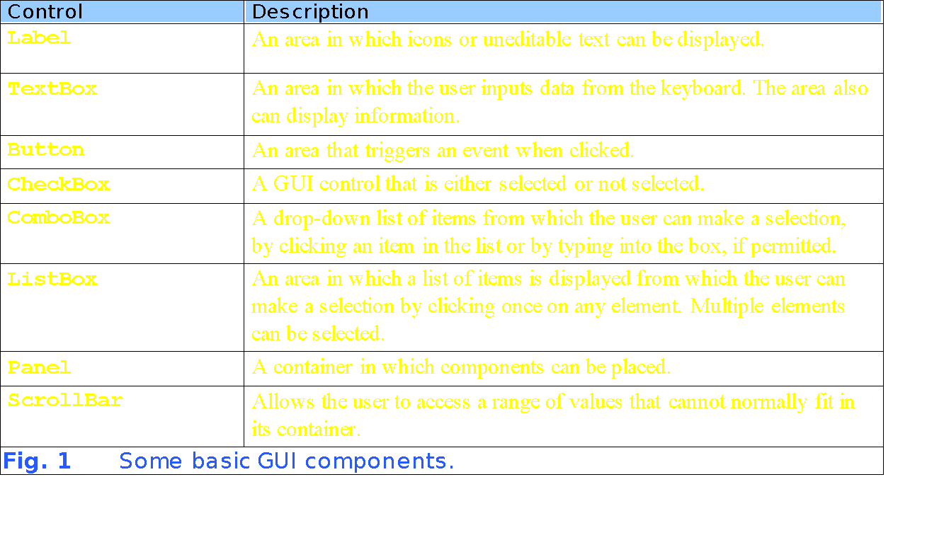
Some common controls
Notes:
‹#›
‹#›

Slide 6
Visual Studio .NET
Provides a set of tools that simplifies Forms programming
Uses the “wysiwyg” approach
Provides comprehensive toolbox of controls that can be dragged & dropped from within the IDE
Each control is configured using a set of properties
Controlled at run time (within the program code) by responding to events, setting properties and calling methods
Notes:
‹#›

Slide 7
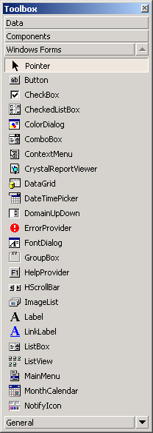
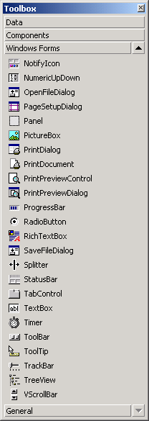
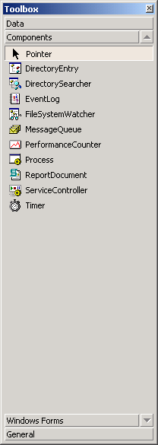
Windows Forms
Available Components and controls for Windows Forms.
Notes:
‹#›
‹#›

Slide 8
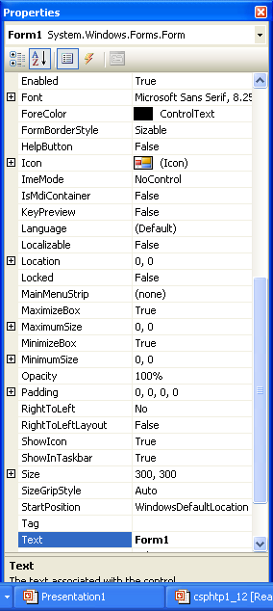
Features of components
All components have many properties, methods and events – some more useful than others.
Use the properties window to see all of them
Notes:
‹#›
‹#›

Slide 9
Creating and displaying a Form within VS .NET
Usually achieved by creating a Windows application using .NET Visual Studio
Creates MANAGED CODE – can be supplemented by own code
partial keyword Separates same class across more than one file
Uses inheritance (from Form class) and partial classes (avoid these if you can)‏
Notes:
‹#›
‹#›

Slide 10
FOR REF Creating a Form, part II
Partial keyword allows the implementation of the class to be split across several files.
using System;
using System.Windows.Forms;
namespace FormPropertiesExample
{
public partial class Form1 : Form
{
public Form1()‏
{
InitializeComponent();
//entry point for your code (Main is in the managed code)
//here we are out of the static context
}
}
}
Typical code created by Visual Studio
Managed code called here
Notes:
‹#›
‹#›

Slide 11
Summary of Windows Forms designer generated code
Tends to split code across files – examine all the .cs files.
Uses an InitializeComponent() method to do most of the instantiation of components on the GUI – generally invoked in the constructor.
The code inside the InitializeComponent() method basically copies the values from the property window of the IDE.
Perfectly possible to add own components outside auto-generated code.

Slide 12
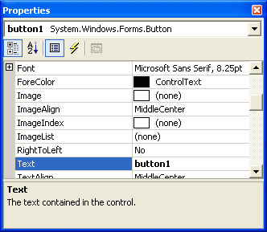
Setting Form and component properties
Easy to do at compile time & at run-time
button1.Text = “A new title";
Notes:
‹#›
‹#›

Slide 13
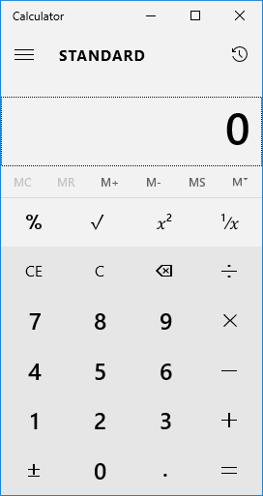
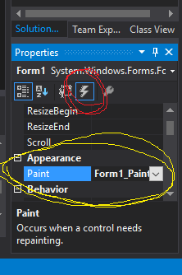
Event Driven Programs

Slide 14
GDI+ Overview
GDI+ is a graphics device interface that allows programmers to have fine control over graphical output
In .NET the GDI+ classes used for drawing and other tasks reside in the following namespaces
System.Drawing,
System.Drawing.Drawing2D,
System.Printing,
System.Internal,
System.Text System.Imaging
System.Design
Depending on the application some or all of these will have to be added to your project with the ‘using’ keyword, e.g. using System.Drawing.Drawing2D;
Note:- Each namespace is a logical grouping of classes and is implemented in a particular DLL
Notes:
‹#›
‹#›

Slide 15
Using GDI+
To use GDI+ you create (or get given) a Graphics object. This Graphics object is at the core of GDI+.
Once you have such an object you can invoke methods against that object, e.g.
g.DrawLine(<parameters>);
Other classes are also provided which are used to help with the drawing activities.
These are Classes such as Pen, Rectangle, Point, SolidBrush, Color, etc.
Notes:
‹#›

Slide 16
Some methods of the Graphics class
DrawArc Draws an arc from the specified ellipse.
DrawBezier Draws a cubic bezier curve.
DrawBeziers Draws a series of cubic Bezier curves.
DrawClosedCurve Draws a closed curve defined by an array of points.
DrawCurve Draws a curve defined by an array of points.
DrawEllipse Draws an ellipse.
DrawImage Draws an image.
DrawLine Draws a line.
DrawPath Draws the lines and curves defined by a GraphicsPath.
DrawPie Draws the outline of a pie section.
DrawPolygon Draws the outline of a polygon.
DrawRectangle Draws the outline of a rectangle.
DrawString Draws a string.
FillEllipse Fills the interior of an ellipse defined by a bounding rectangle.
FillPath Fills the interior of a path.
FillPie Fills the interior of a pie section.
FillPolygon Fills the interior of a polygon defined by an array of points.
FillRectangle Fills the interior of a rectangle with a Brush…
Notes:
‹#›

Slide 17
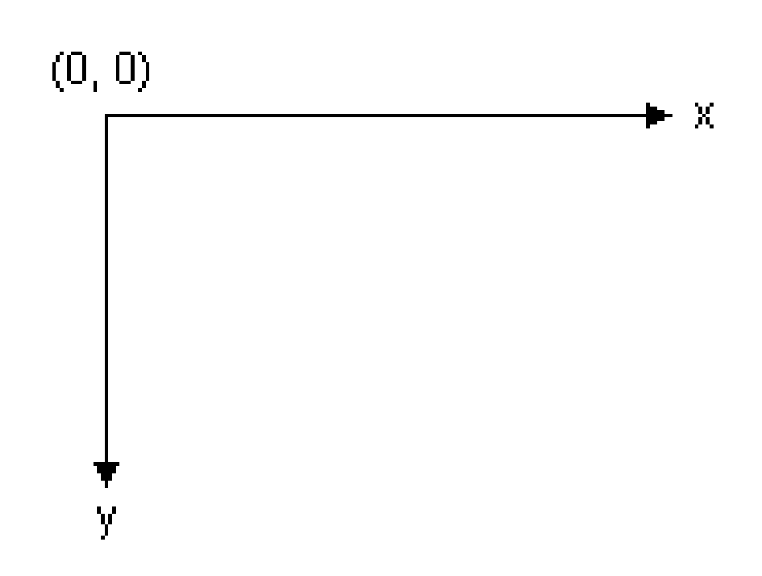
The Process of Drawing
GDI+ draws lines, rectangles etc.. on a co-ordinate system
The default co-ordinate system has the origin in the upper left corner with the x-axis pointing to the right and the y-axis pointing down.
Notes:
‹#›

Slide 18
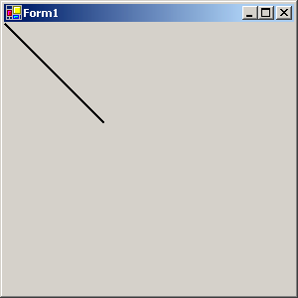
Drawing a Line
private void Form1_Paint(object sender,System.Windows.Forms.PaintEventArgs e)‏
{
Graphics g =e.Graphics; //create graphics object g
Pen myPen = new Pen(Color.Black,2); //create a pen object
g.DrawLine(myPen,0,0,100,100); //use the DrawLine method
}
Notes:
‹#›

Slide 19
Paint events
When a window is resized or restored from a minimised state a Paint event message is sent by the operating system to tell an application to redraw any graphics that is being displayed
Consequently any drawing code should be placed in a Paint event method associated with the Form or other control (PictureBox)‏
The Paint event will fire whenever the application needs to be redrawn and can be forced using the Refresh method
Code within a Paint event handler needs to respond to the paint message
A paint method is invoked with an object (the sender) and a PaintEventArgs class (defined as e unless changed)‏
Skeletal code for a Form Paint event handler is shown below
private void Form1_Paint(object sender, System.Windows.Forms.PaintEventArgs e)‏
{
// Drawing code to be added here
}
Notes:
‹#›

Slide 20
Lines and Shapes Sample Code
private void pictureBox1_Paint(object sender, System.Windows.Forms.PaintEventArgs e)‏
{
Point pt1 = new Point(0,0); //create a point pt1 object
Point pt2 = new Point(200,200); //create a point pt2 object
Rectangle rect1 =new Rectangle(50,80,100,130); // rect1 object
Graphics g = e.Graphics; // get a reference to Graphics object
Pen myBlackPen = new Pen(Color.Black,5); //create a pen object
// call the DrawLine() method of the graphics object
g.DrawLine(myBlackPen,pt1,pt2);
g.DrawLine(myBlackPen,0,50,200,50);
// call the DrawEllipse() method of the graphics object
g.DrawEllipse(myBlackPen,50,50,200,100);
// call the DrawRectangle() method of the graphics object
g.DrawRectangle(myBlackPen,rect1);
myBlackPen.Dispose();
}
Notes:
‹#›

Slide 21
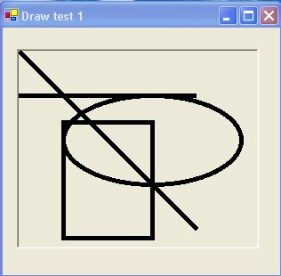
Lines and Shapes
Notes:
‹#›

Slide 22
Key points relating to code
The code creates point and rectangle objects which can be used in the DrawLine() and DrawRectangle() methods
A graphics object ‘g’ is created
When you draw on paper by hand you choose a pen with the right characteristics (colour and width) to get the effect you want. Similarly, when drawing with a graphics object you need to specify a pen object
A pen object is created whose colour is black and width is 5
Java doesn’t quite do it like this
You can change the Width using
myBlackPen.Width=3;
DrawLine(), DrawEllipse() and DrawRectangle() methods are demonstrated
The Dispose() method is used to release resources associated with the pen object.
Notes:
‹#›

Slide 23
Off screen bitmaps
You can draw onto a bitmap and display it when it is ready
You can draw on your bitmap in any method
but display it in the paint method
myBitmap = new Bitmap(640,480);
g = Graphics.FromImage(myBitmap); // get the graphics contact so that we can draw on the bitmap
Pen p = new Pen(Color.Red, 2); //red pen 2 pixels wide
g.DrawLine(p, 0, 0, 640, 480);
Nothing is seen

Slide 24
Displaying a bitmap
A bitmap should be displayed using the paint method()
private void Form1_Paint(object sender, PaintEventArgs e)
{
//put the bitmap on the window
Graphics windowG = e.Graphics;
windowG.DrawImageUnscaled(myBitmap, 0, 0);
}
Paint will be called by the system when the window needs redrawing
Or manually by calling the objet’s invalidate() method.
….

Slide 25
Bezier and Polygon Draw Example
private void pictureBox1_Paint(object sender, System.Windows.Forms.PaintEventArgs e)‏
{
Graphics g = e.Graphics; // create a graphics object
// Draw Bezier curve
g.DrawBezier(new Pen(Color.BlueViolet,5),
new Point(50,60),new Point(150,10),
new Point(200,230),new Point(100,100));
//Polygon points
PointF point1 = new PointF(50.0f,250.0f);
PointF point2 = new PointF(100.0f,25.0f);
PointF point3 = new PointF(150.0f,5.0f);
PointF point4 = new PointF(250.0f,50.0f);
PointF point5 = new PointF(300.0f,100.0f);
PointF[] polygonPoints = {point1,point2,point3,point4,point5};
// Drawpolygon
g.DrawPolygon(new Pen(Color.Chocolate,10),polygonPoints);
}
Notes:
‹#›

Slide 26
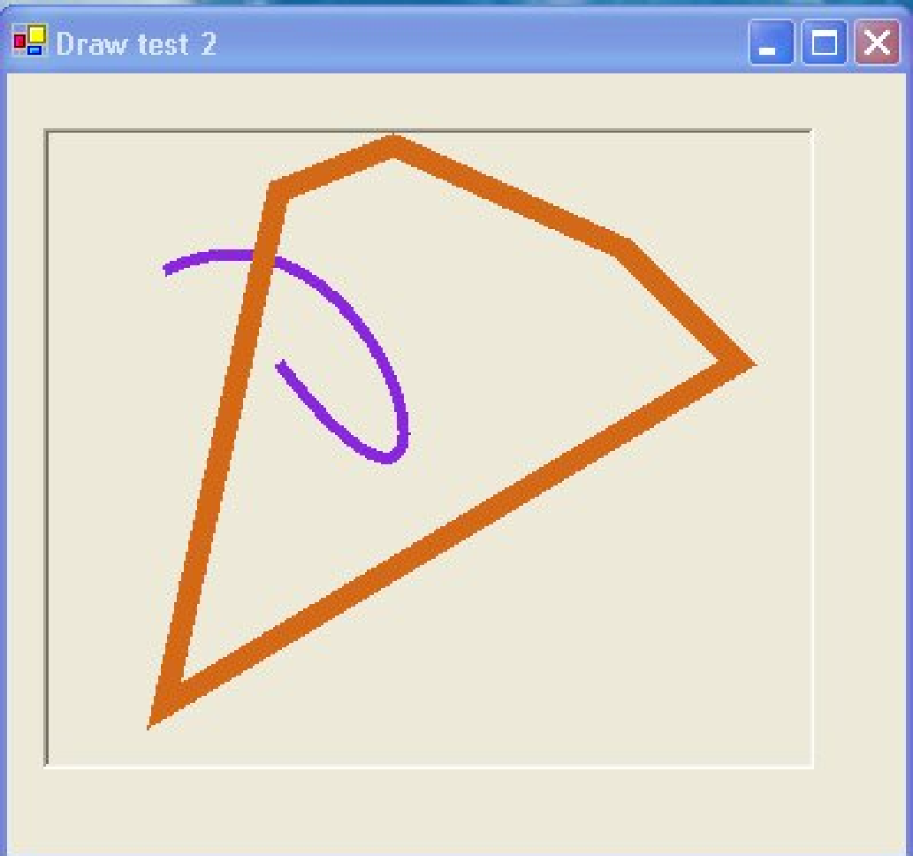
Bezier Curves and Polygons
Notes:
‹#›

Slide 27
Pens and Brushes
You also need to create pen and brush objects when using Draw and Fill methods
The main thing to remember is the difference between pens and brushes
Pens are used to draw lines that might include a single line, curve or the outside of a closed shape (rectangle, ellipse etc)‏
Brushes fill interiors of closed shapes.
Notes:
‹#›

Slide 28
Brush Sample Code
using System.Drawing.Drawing2D; // needed for LinearGradientBrush
private void pictureBox1_Paint(object sender, System.Windows.Forms.PaintEventArgs e)‏
{
Graphics g = e.Graphics; // create a graphics object
Rectangle rect1 = new Rectangle(10,10,50,50);
Rectangle rect2 = new Rectangle(60,60,80,100);
// Solid brush example
SolidBrush Brush1 = new SolidBrush(Color.Aquamarine);
g.FillRectangle(Brush1,rect1);
// Linear gradient brush example (need using Drawing2D)‏
LinearGradientBrush Brush2 = new LinearGradientBrush(rect2,Color.Tan,
Color.SandyBrown,LinearGradientMode.BackwardDiagonal);
g.FillRectangle(Brush2,rect2);
}
Notes:
‹#›

Slide 29
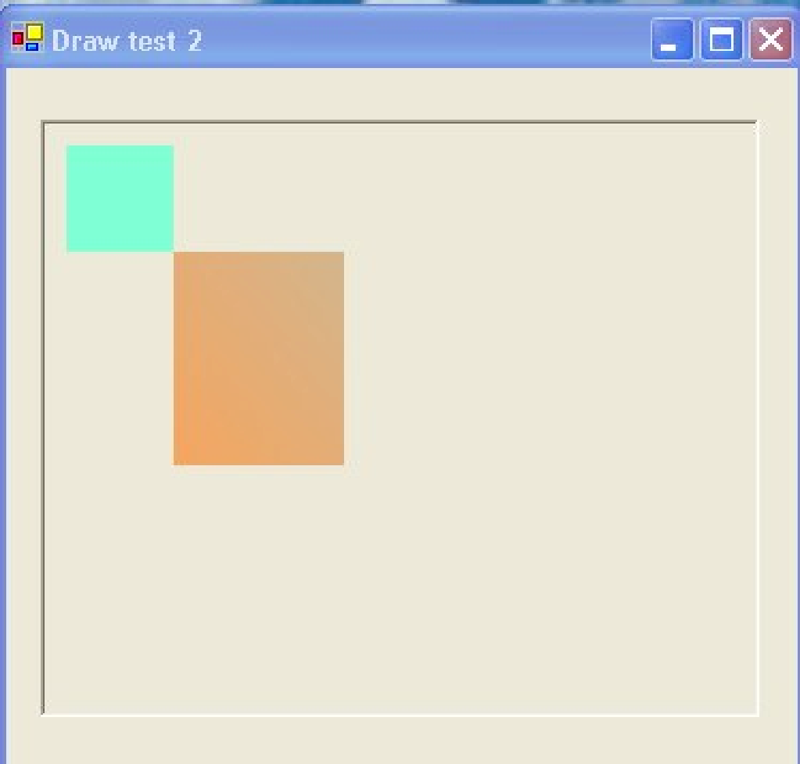
Brush Example
Notes:
‹#›

Slide 30
Types of Co-ordinate System
GDI+ uses three co-ordinate spaces: world, page, and device.
World co-ordinates are the co-ordinates used to model a particular graphic world
Page co-ordinates refer to the co-ordinate system used by a drawing surface, such as a form or control
Device co-ordinates are the co-ordinates used by the physical device being drawn on, such as a screen or printer
The PageUnit property of the graphics class determines how the graphics object will be measured
if you set (g.PageUnit=GraphicsUnit.Inch) then you need to pass inches to the draw methods not pixels.
Notes:
‹#›

Slide 31
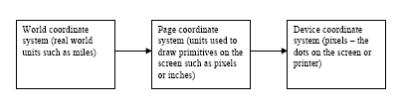
Co-ordinate Transformations
Before GDI+ draws a primitive on the screen, the co-ordinates pass through a sequence of transformations (conversions).
One transformation, called the world transformation, converts world co-ordinates to page co-ordinates,
…and another transformation, called the page transformation, converts page co-ordinates to device co-ordinates…
Notes:
‹#›

Slide 32
Summary
There are many more capabilities of Forms and GDI+ not covered here (this intro. Has been tuned to your needs!)‏
Use the help system to discover what other wonderful facilities are available
You assignment work will be mainly using the Forms classes, but you will need a little GDI+ knowledge to draw the grid and fill the cells.
Remember: GUI’s are “event” driven programs!
Notes:
‹#›

